Slide 1

Chapter 5
Present-Moment Focus

Slide 2
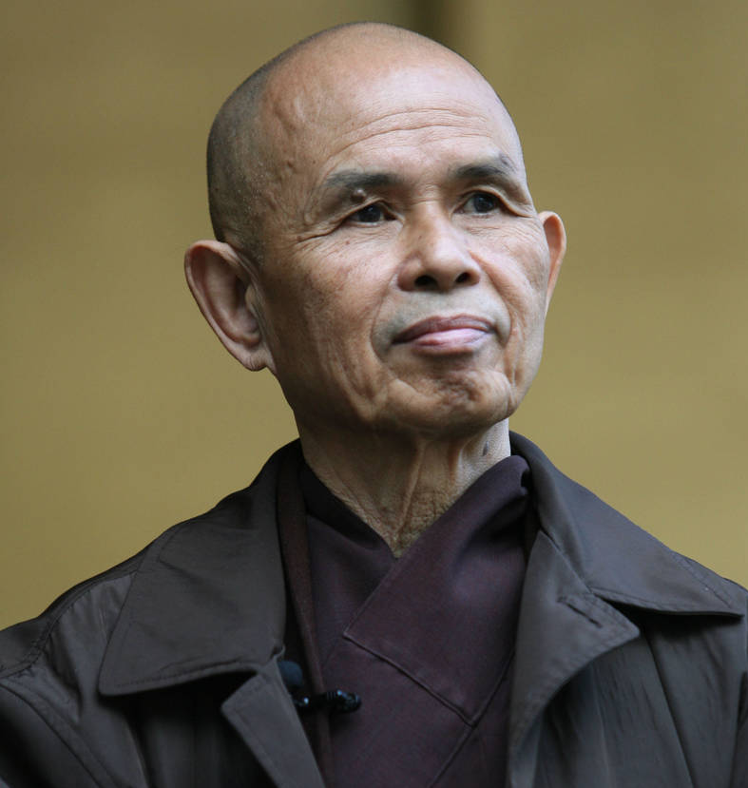
Thích Nhất Hạnh
October 11, 1926 –
January 22, 2022
Vietnamese Buddhist Monk
Credited by many with bringing mindfulness to the United States

Slide 3

Media Multi-Tasking
More media multi-tasking:
  Increased lapses in attention
  Difficulty filtering out irrelevant information
  Less efficient switching from one task to another
  Perform worse on tasks, including schoolwork
2024: College students spend about 25% of class time on phones
Students spent an average of 37/100 minutes of class time browsing internet for non-class relevant info (Ravizza et al., 2016)
  Non-academic internet use associated with lower test scores, even when accounting for ACT scores, interest & motivation in class

Slide 4

Mindfulness
Present-Moment Awareness: purposeful attention to current internal and external environment
Non-judgmental Stance: notice experiences without labeling as good or bad, not evaluating
Non-reactivity: leaving space between you and your experiences
Acceptance: allowing experience as it really is
Beginner’s Mind: approaching present moment as a novice still open to learning

Slide 5
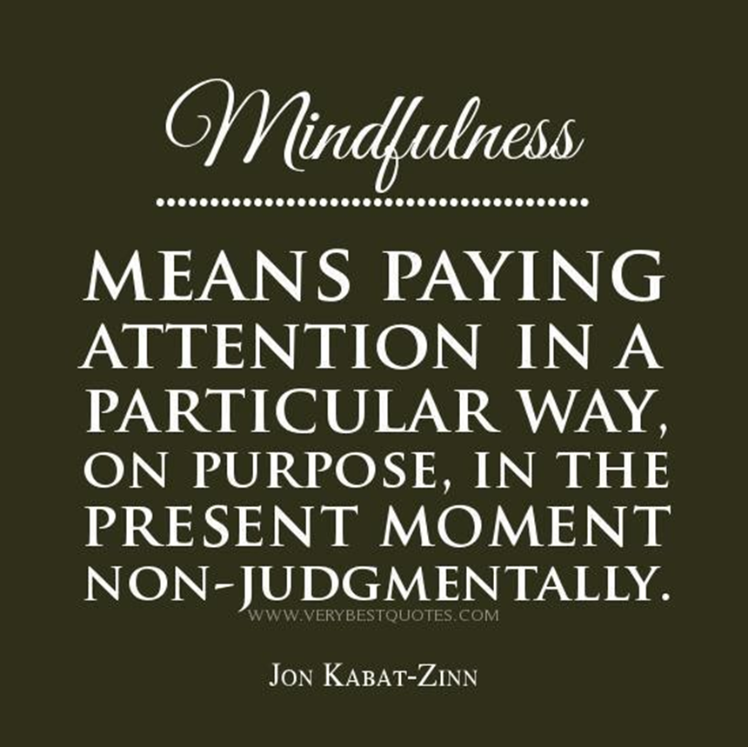

Slide 6
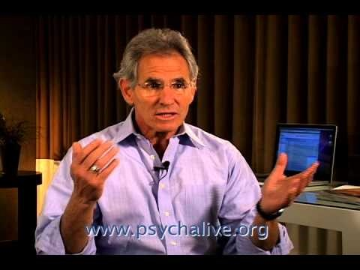

Slide 7
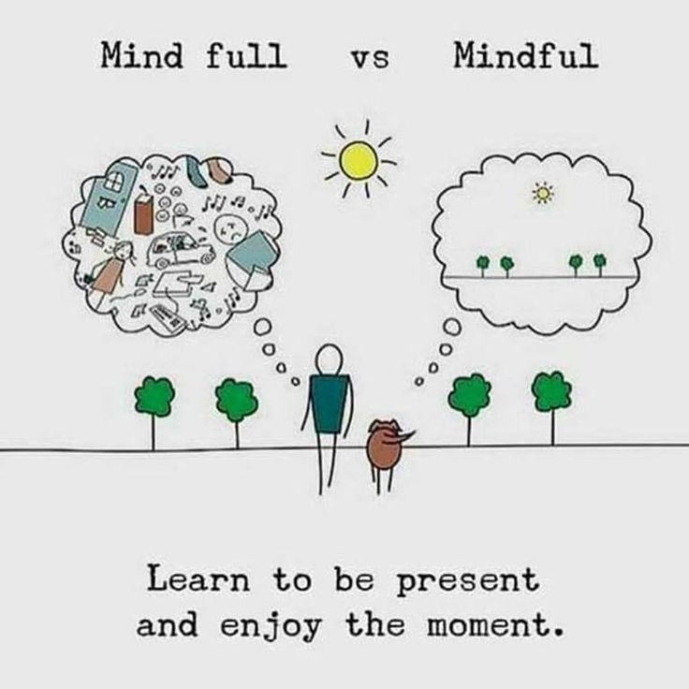

Slide 8
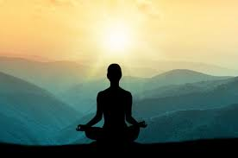
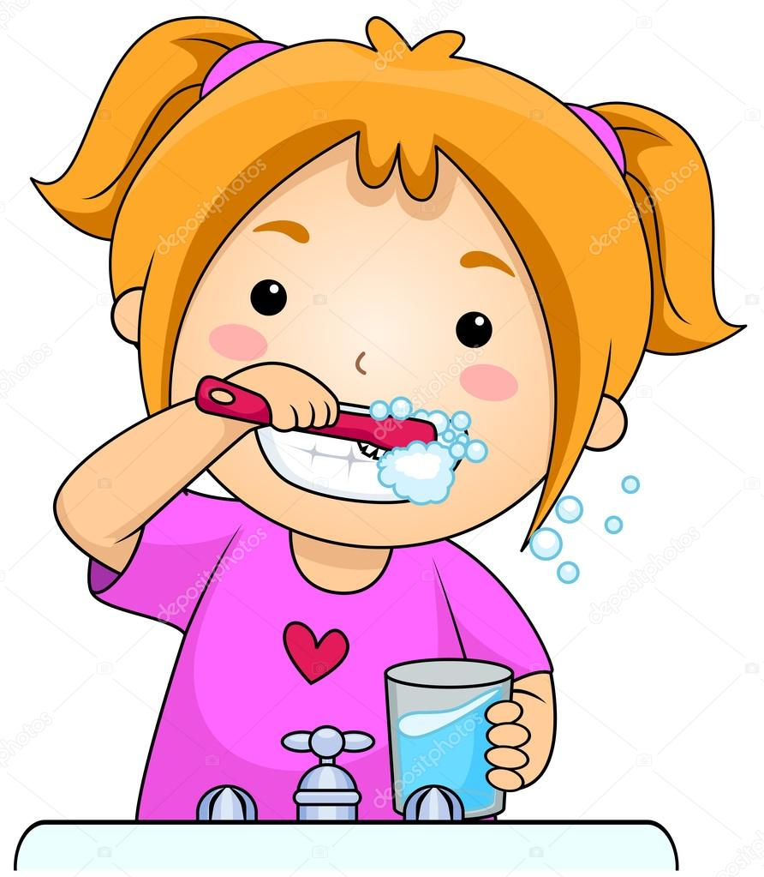
Mindfulness
Mindfulness Meditation
Daily Mindfulness

Slide 9
Mindfulness
State
At the moment
Can be while we are meditating, or performing any task
Trait
Degree of mindfulness we possess and bring to all different types of situations

Slide 10
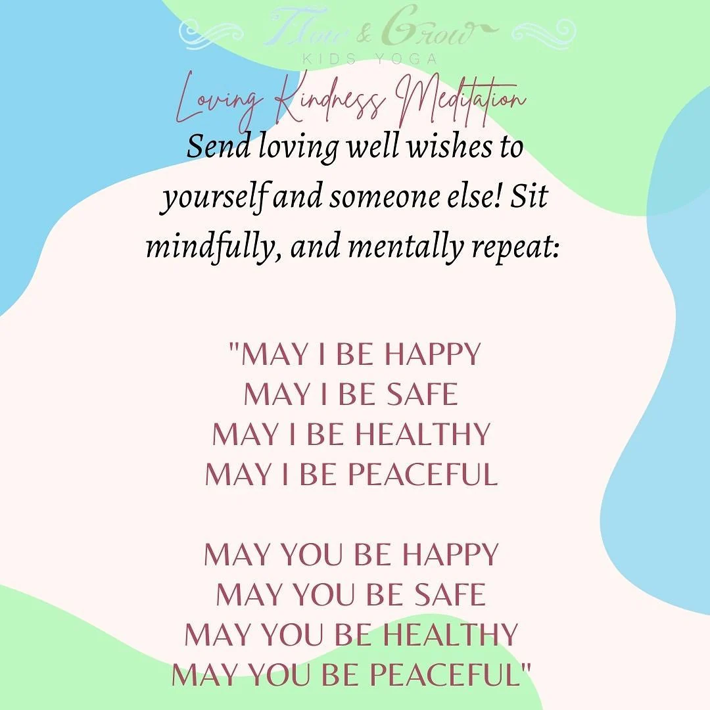

Slide 11
Psychological Benefits of Mindfulness
↓ Stress
↓ Depression
↓Anxiety
↓Rumination
↑ Emotion Regulation
↑ Attention, concentration
↑ Self-awareness
↑ Resilience, WB, Life satis
↑ Compassion, empathy
↑Sleep

Slide 12
Trait Mindfulness and Prosocial Behaviors
More mindful people:
  Less likely to self-report ostracizing others
  More likely to include those being ostracized by others in game of Cyberball, even after accounting for personal distress and empathy (Jones et al., 2019)
In 12 studies (N = 13,820), mindfulness associated with prosocial behaviors (Donald et al., 2019)
  Especially when participants already knows target
  Relationship most strong in adults, then emerging adults, then adolescents

Slide 13

Types of Mindfulness Practices
Focused attention, examples include:
  Breath Awareness
  Walking
  Body scan
  Gatha meditation
Open Awareness
Loving-Kindness Meditation
Mindfulness-Based Stress Reduction Program

Slide 14

An example of a Gatha poem

Slide 15

Let’s Mindfully Meditate
https://insighttimer.com/

Slide 16

Well-Being Journal Entry #11
Mindfulness Meditation
  Was this your first time?
  How did you find the experience?
  Did you find your mind wandering?
  Questions you have

Slide 17
Mindfulness Interventions & Physical Functioning
Mindfulness Interventions:
  Decrease pain, improve coping, and lead to higher functioning for those with chronic pain conditions (compared to TAU; Creswell et al., 2014 review)
  Result in fewer acute respiratory illness days and shortness duration of illness during cold and flu season (compared to no treatment; Barrett et al., 2018)
  Compared to lifestyle-education group, leads to lower levels of markers of chronic inflammation for those with or at risk for cardiovascular disease (Malarkey et al., 2013) and, compared to relaxation intervention, in stressed job-seekers (Creswell et al., 2016)

Slide 18
Mindfulness Interventions & Physical Functioning
Mindfulness techniques help improve physical health in a number of ways:
  Can help relieve stress
  Treat heart disease
  Lower blood pressure
  Reduce chronic pain (technically, it is changing our relationship with chronic pain)
  Improve sleep
  Alleviate gastrointestinal difficulties

Slide 19
Mindfulness Interventions & Psychological Functioning
Improvements in:
  Symptoms of anxiety
  Symptoms of depression
  Stress
  Likelihood of relapsing after successful treatment for depression
  Quality of life
  Sustained attention
  Working memory
  Problem-solving
  Positive affect
  Negative Affect
  Rumination

Slide 20
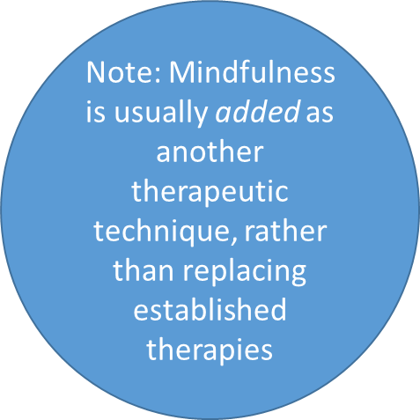
Benefit of Mindfulness:
Mental Health
Depression
Substance abuse
Eating disorders
Couples’ conflicts
Anxiety disorders
Obsessive-compulsive disorder

Slide 21
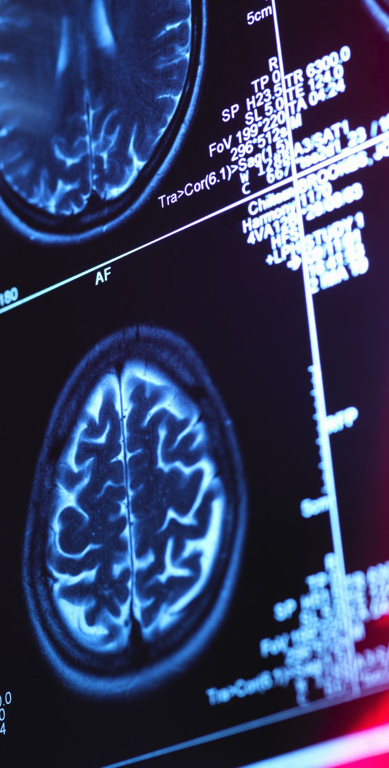
Your Brain on Mindfulness
Mindfulness practices and interventions are associated with neural activation patterns thought to indicate:
  Interoceptive Awareness
    Insula - increased activation; may be particularly related to repeated and intentional focus on the present moment
  Emotion Regulation
    Prefrontal Cortex – increased activation
    Dorsal Anterior Cingulate Cortex – increased activation
    Amygdala – decreased activation
    Some evidence of greater connectivity between prefrontal cortex and amygdala for meditators

Slide 22
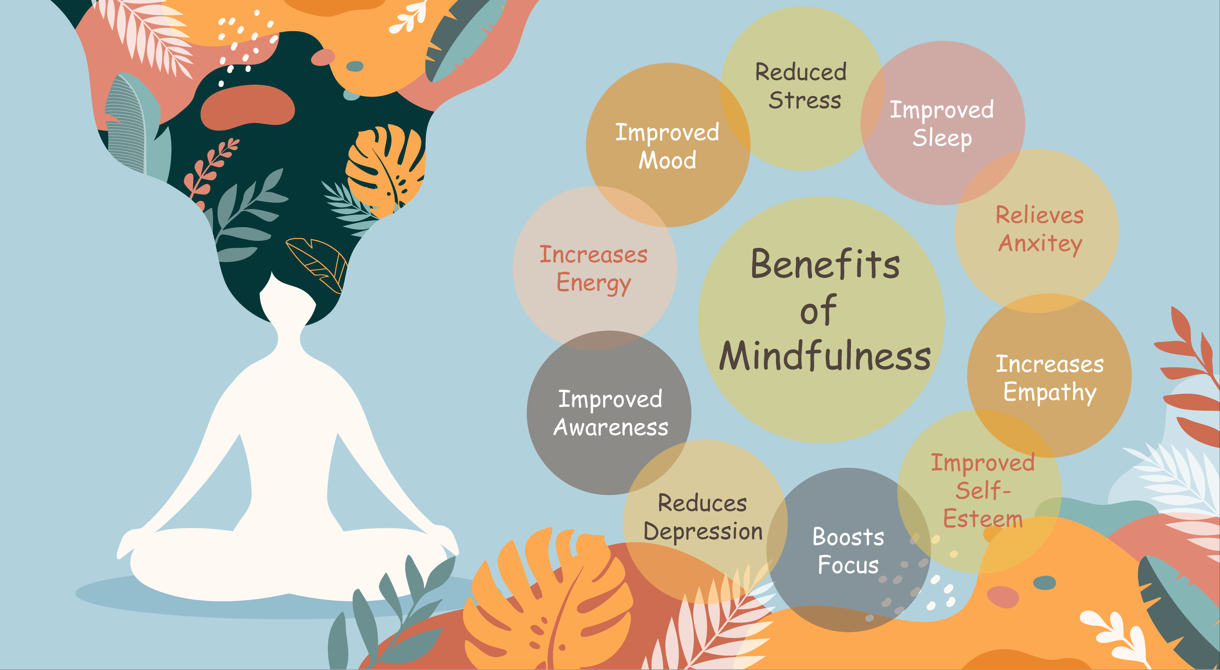
How does mindfulness work?

Slide 23
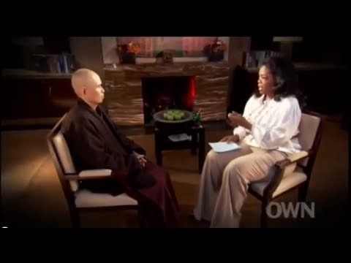

Slide 24

Savoring
The process of up-regulating positive emotions by redirecting attention in the moment to positive emotional experiences
Associated with positive affect in the present and future and relationship satisfaction
Awareness of pleasure and focused attention on the sensation and delight in it

Slide 25
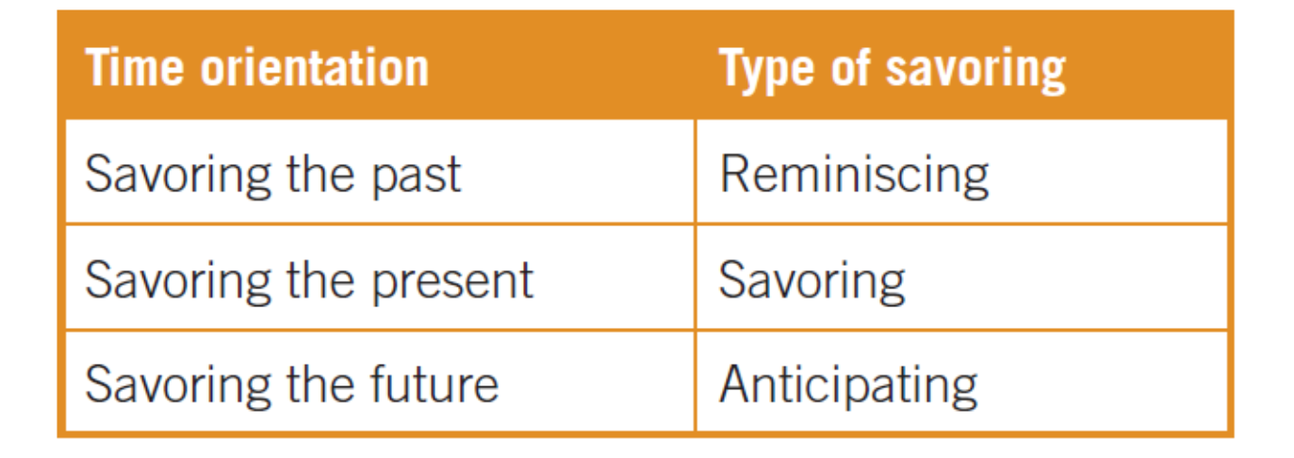
Savoring

Slide 26

Savoring
Four basic types of savoring:
  Basking
    Receiving praise and congratulations
  Marveling
    Getting lost in the wonder of a moment
  Luxuriating
    Indulging in a sensation
  Thanksgiving
    Expressing gratitude

Slide 27

Savoring
Five Ways to Enhance/Promote Savoring
  Absorption
  Sharpening the senses
  Memory building
    Take pictures, buy souvenirs
  Sharing with others
  Self-congratulation

Slide 28
Well-Being Journal Entry #12: Savoring Accomplishments
Write about a time in your past when you felt proud of yourself. As you think about this accomplishment, picture it exactly as it was (perhaps close your eyes)
Where were you? Who was there? What did you do? How did you feel?
Return to this experience any time you want to boost positive emotion

Slide 29
Conditions that Enhance Savoring
More likely to savor something considered to be special or out-of-the ordinary (Quoidbach et al., 2015)
More likely to savor positive emotional experiences when a task is already completed (Schall et al., 2017)
More likely to savor experiences if you believe you have faced and overcome challenges in life (Croft et al., 2014)
  Past adversity positively correlated with savoring, current adversity inversely correlated with savoring

Slide 30
Savoring and Task Completion
Students asked to imagine successfully:
1. Completing one final exam with another scheduled for later in the day (Task in Progress)
2. Completing all final exams for the semester

Slide 31
Well-Being Journal #13: Savoring
Plan a Perfect Day
  Set aside a period of time for the next weekend
  Plan what you would like to do
  Allow yourself to follow through and do the things you planned
  Reflect how you feel after follow through

Slide 32
Flow
(Nakamura & Csikszentmihalyi, 2001)
A state of complete absorption in an intrinsically rewarding activity
Focused concentration on what you are doing in the present moment combined with sense of control over activity
Experience time as passing without realizing it
Self-reinforcing state

Slide 33
Conditions that Facilitate Flow
Proximal goals are clearly established
  Goals are evident for each step of the activity
Immediate feedback on actions
  From others
  From environment
  Actions are merged with awareness
Challenge of the activity and skills to meet the challenge are balanced

Slide 34
Flow Channel

Slide 35
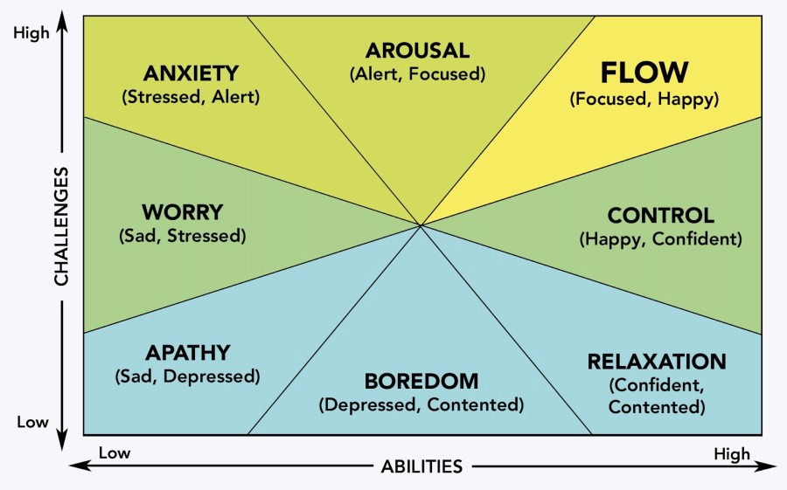
Flow and Optimal Experience
Characteristics of Flow
State of flow described using 8 parameters
Flow accompanies a challenging activity that requires skill
Notes:
State of flow can be described with eight parameters: Merging of action and awareness, complete concentration on the task at hand, lack of worry about losing control, a loss of self-consciousness, time no longer pass in ordinary ways, autotelic nature of the experience.

Slide 36

Flow and Optimal Experience
Characteristics of Flow
Merging of action and awareness
Intense and focused concentration
Greater sense of control
A loss of self-consciousness
Notes:
State of flow can be described with eight parameters: Merging of action and awareness, complete concentration on the task at hand, lack of worry about losing control, a loss of self-consciousness, time no longer pass in ordinary ways, autotelic nature of the experience.

Slide 37

Flow and Optimal Experience
Characteristics of Flow
5. Distortion of temporal experience
6. Autotelic nature of the experience (process is intrinsically motivating)
Conditions Under Which Flow is More Likely:
7. Challenge-skill
8. Activity provides clear goals and immediate feedback
Notes:
State of flow can be described with eight parameters: Merging of action and awareness, complete concentration on the task at hand, lack of worry about losing control, a loss of self-consciousness, time no longer pass in ordinary ways, autotelic nature of the experience.

Slide 38
Flow and Optimal Experience
Contexts and Situations of Flow
Contexts: religious rituals, teaching, family interactions, cramming, online learning, psychotherapy, military combat, sports, exercise, reading, music
Flow experiences may be the key to job satisfaction
  Work engagement
    Vigor
    Dedication
    Absorption
Allows people to enjoy life, feel happier, and function better

Slide 39

Flow and Optimal Experience
Contexts and Situations of Flow: Is Flow a State or a Trait?
If flow is a state
A state of consciousness that can occur to anyone with the same amount of effort given the right circumstances
If flow is a trait (dispositional flow)
There should be innate differences in how easily individuals can experience flow
Some twin research suggests flow proneness related to genetically linked personality traits of extraversion, agreeableness, and openness to experience

Slide 40
Flow and Optimal Experience
Flow and Subjective Well-Being
Research on flow began with asking people about moments of well-being
Study relationships between being in frequent flow experiences and increased well-being
  Flow is a significant component of leisure activities, so in this way flow is related to leisure and satisfaction
  Flow related to intrinsically motivated activities…keep repeated activities that produce flow (even though they receive no recognition or money to do so)

Slide 41

Flow and Optimal Experience
Comments on the Theory of Flow
Not all studies have supported the predictions of the flow theory
Flow experience is not always present in a specific activity
If flow activity is present, it may not be present throughout the duration of the activity
Flow is fostered by intrinsic interest in and curiosity about the task

